Slide 1
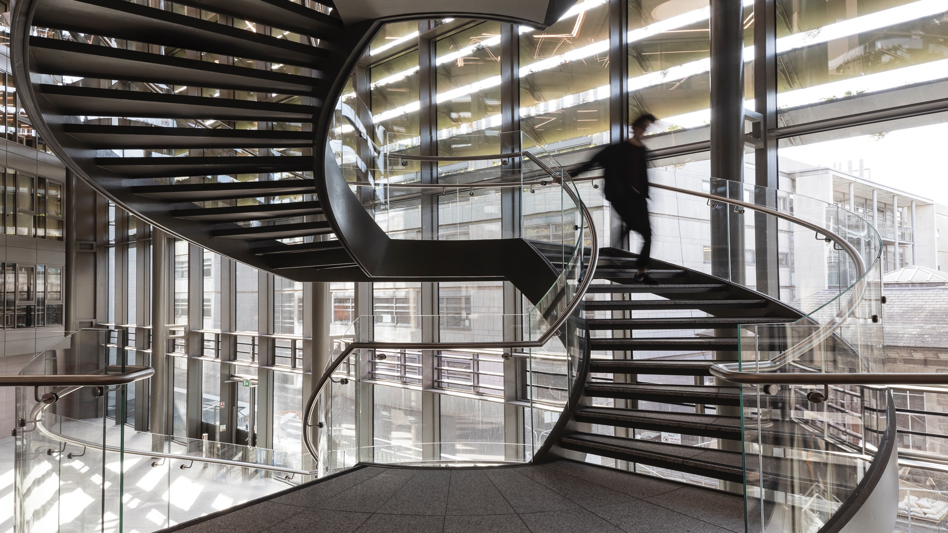

Postgraduate Orientation Week Research Tips with the Experts
Christoph Schmidt-Supprian – Library
Jennifer Daly – Trinity Research
Corrinna Moore – Trinity Research
Jessica Wang – Trinity Research
Kate Smith– Trinity Research

Slide 2

Your Research and the Library
David Mockler
  Medical Librarian
Trinity College Dublin, The University of Dublin

Slide 3
Quote Slide Option 1
The Library is Here for You

Slide 4

Quote Slide Option 1
library@tcd.ie
https://www.tcd.ie/library/
Live Chat
01-896-1127
Reading Room Service Desks
Subject Librarians
Specialists

Slide 5
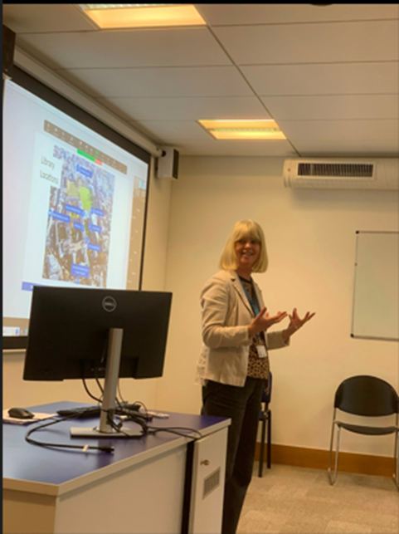
Your Subject Librarian
Your first port of call for assistance with identifying quality research evidence
Provides 1:1 or small group research consultations
Shares time saving tips and tools for managing your research process
Provides evidence synthesis support for systematic or scoping review projects

Slide 6
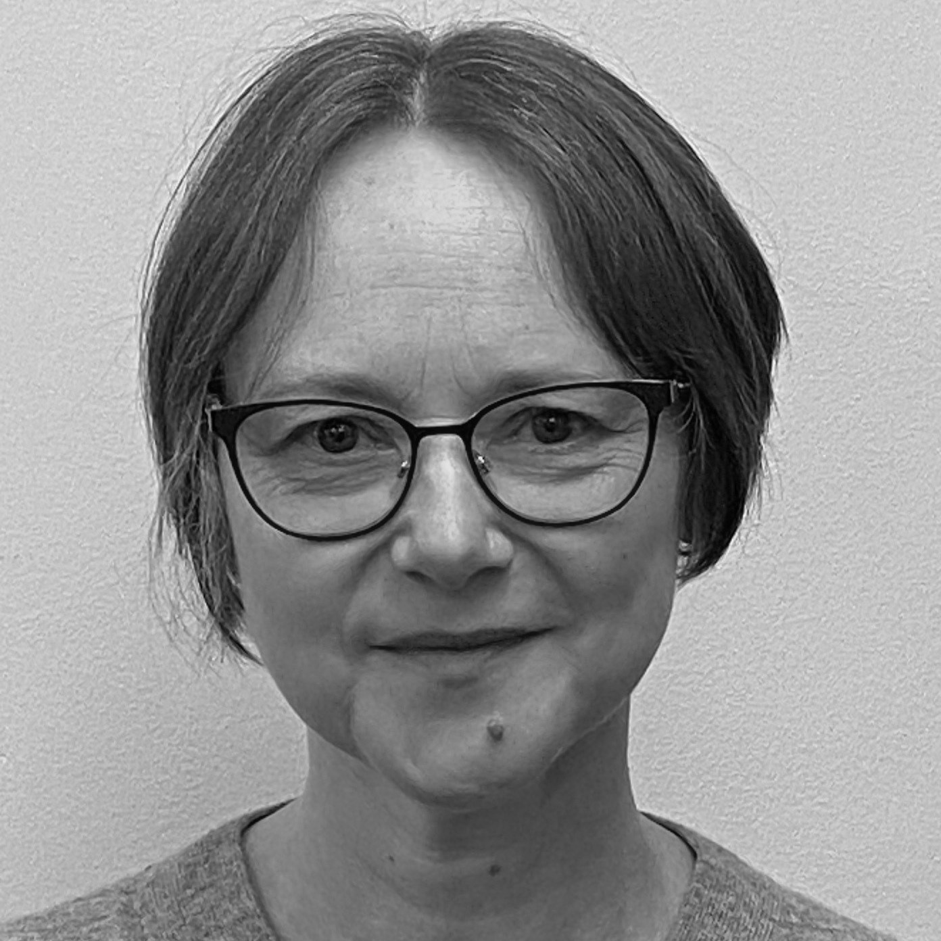
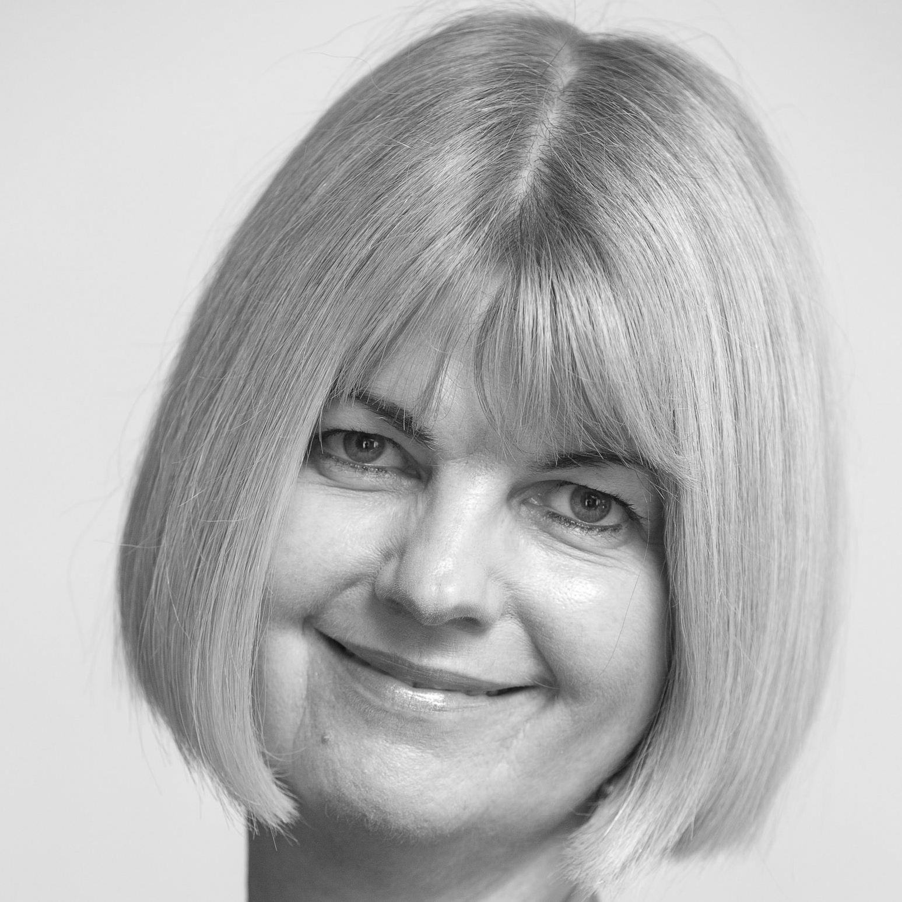
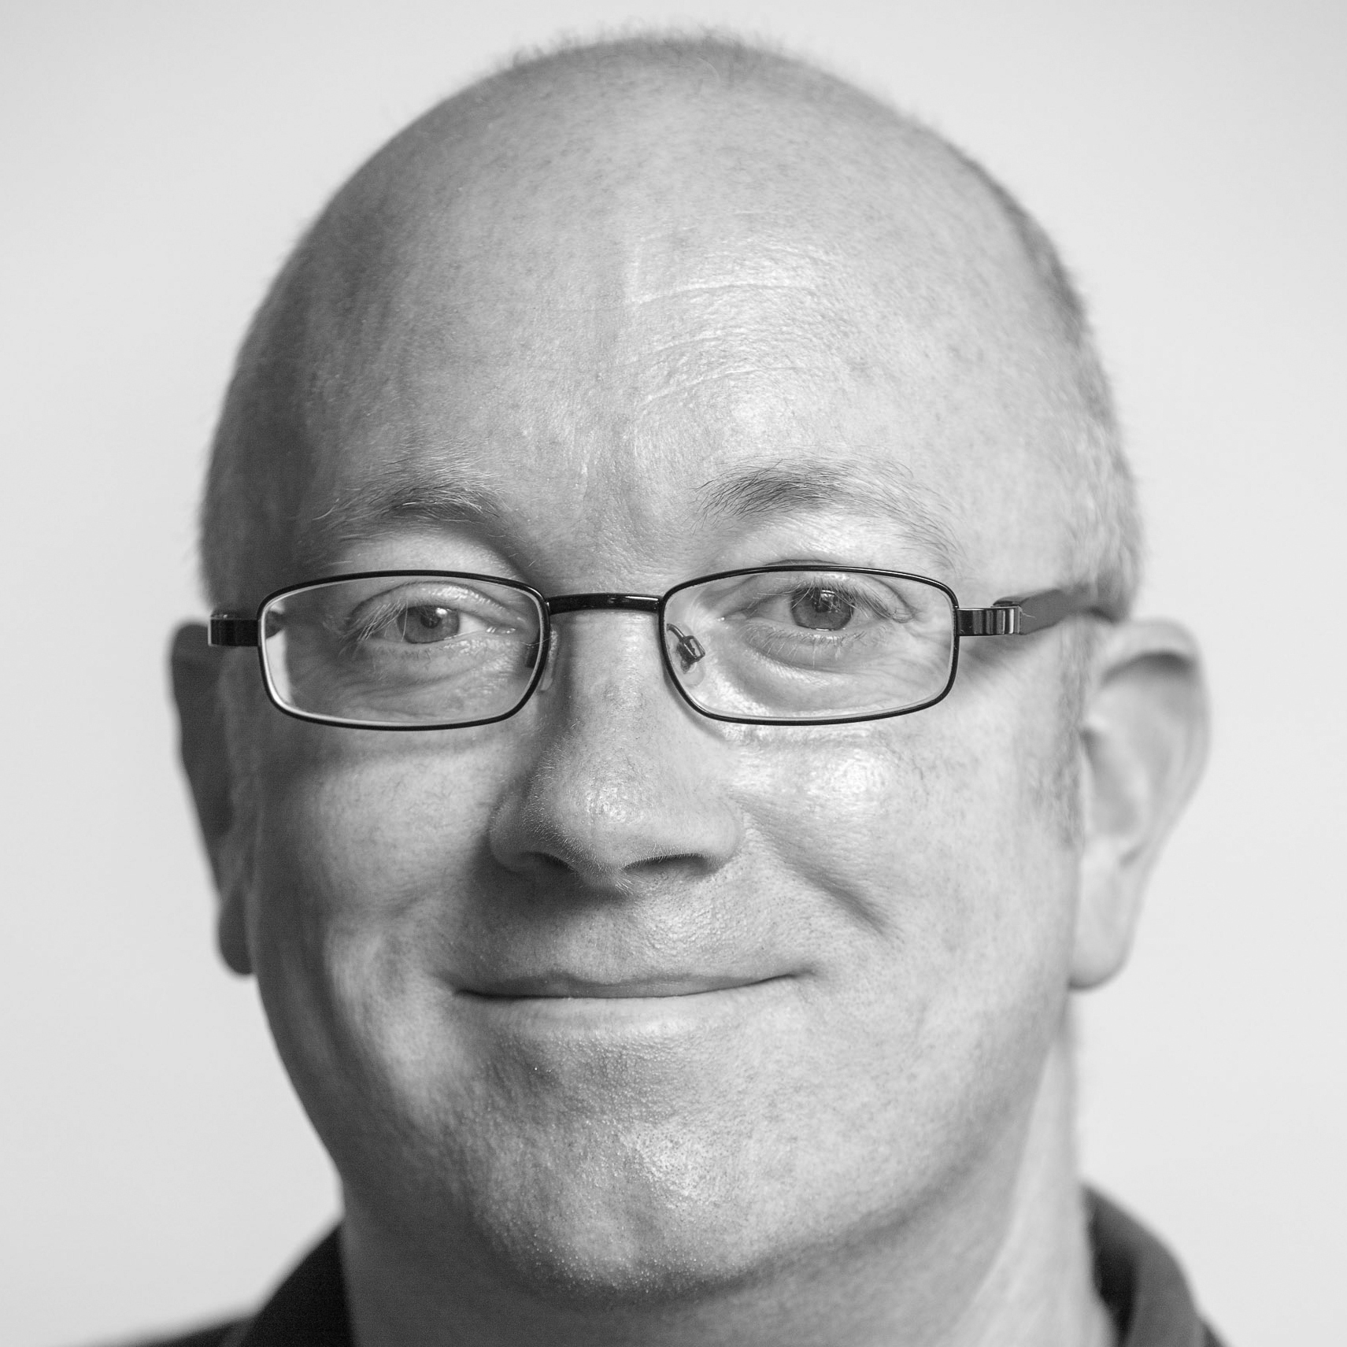
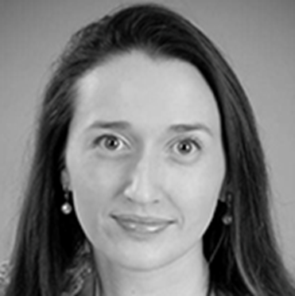
Arts, Humanities & Social Sciences
Helen Bradley
Isolde Harpur
David MacNaughton
Caroline Montgomery
Drama
European Studies
Film
History of Art & Architecture
Asian Studies
English
German
Linguistic, Speech
& Communication Sciences
Russian & Slavonic Studies
Business
Economics
Engineering
Mathematics
Philosophy
Political Science
Sociology
French
History
Irish; Italian
Near & Middle Eastern Studies
Religion
Spanish
Social Work & Social Policy

Slide 7
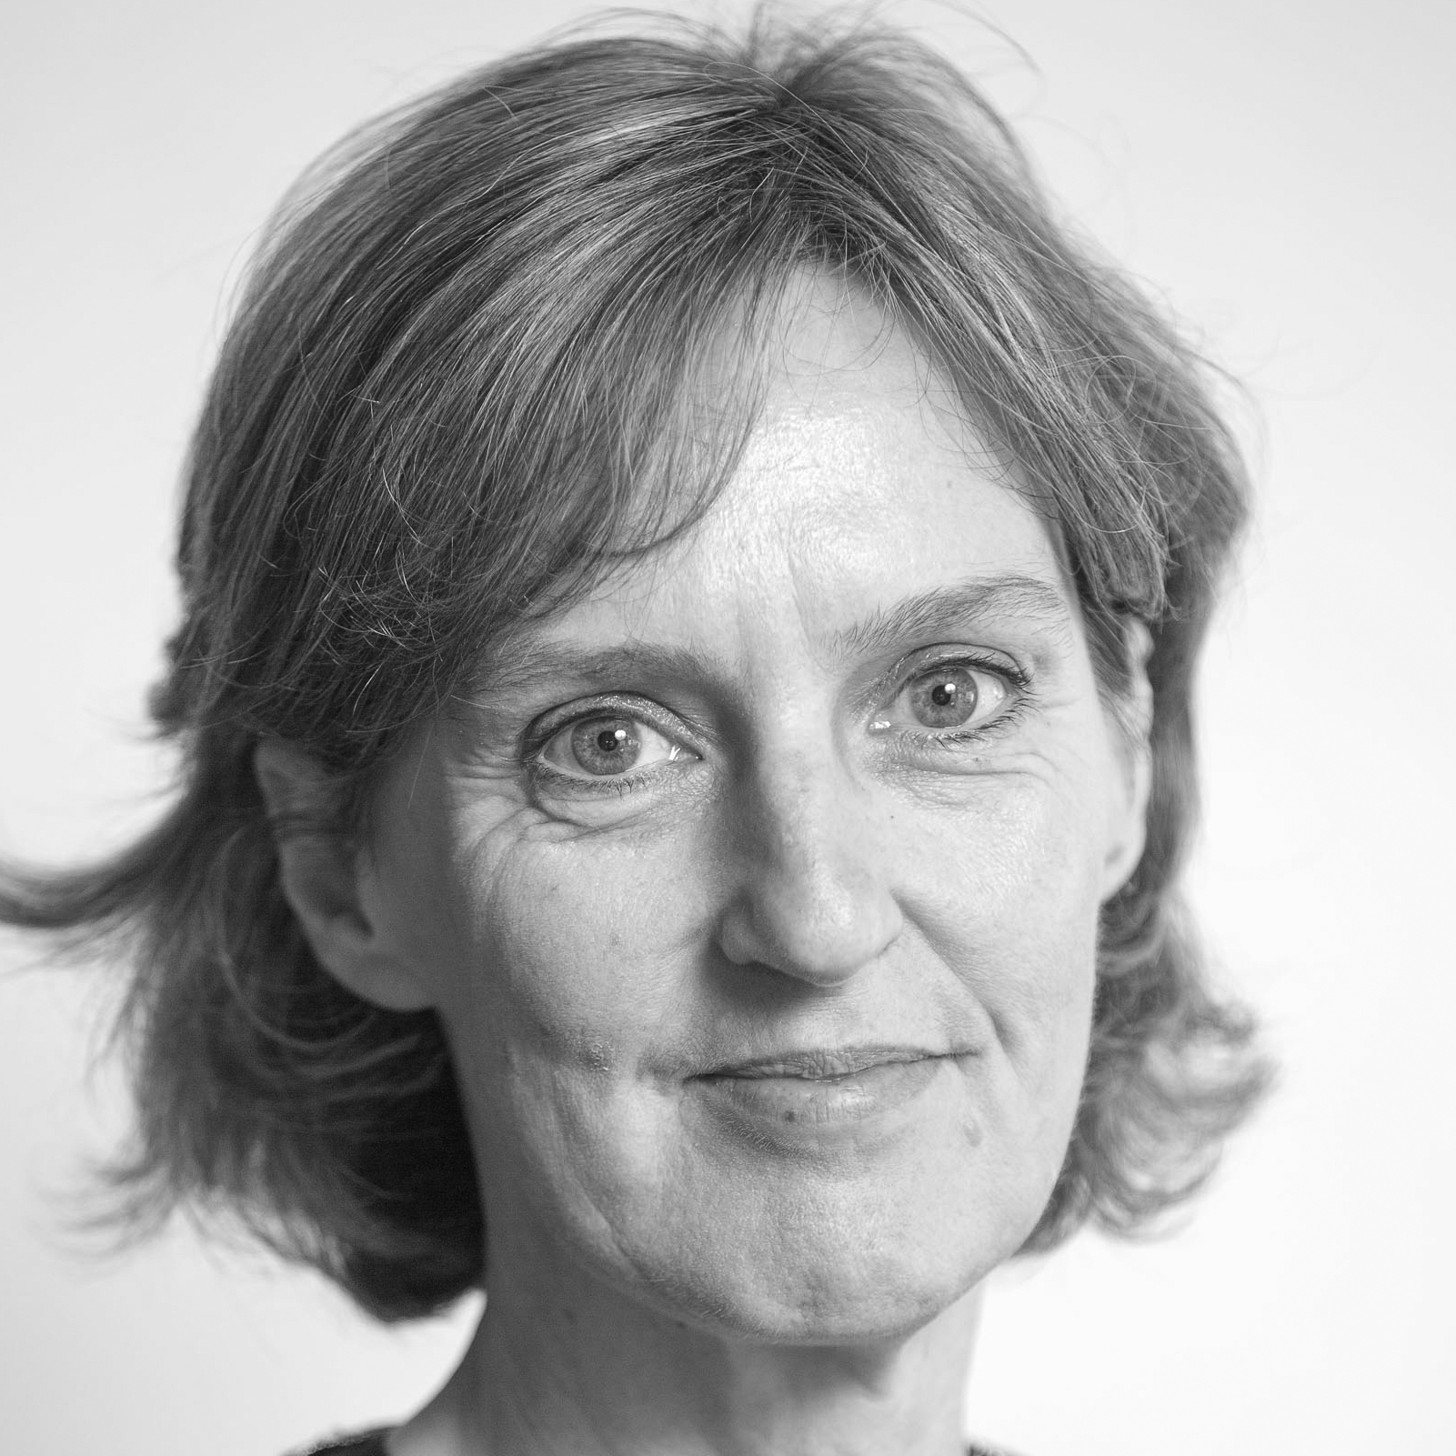
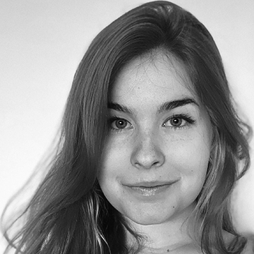
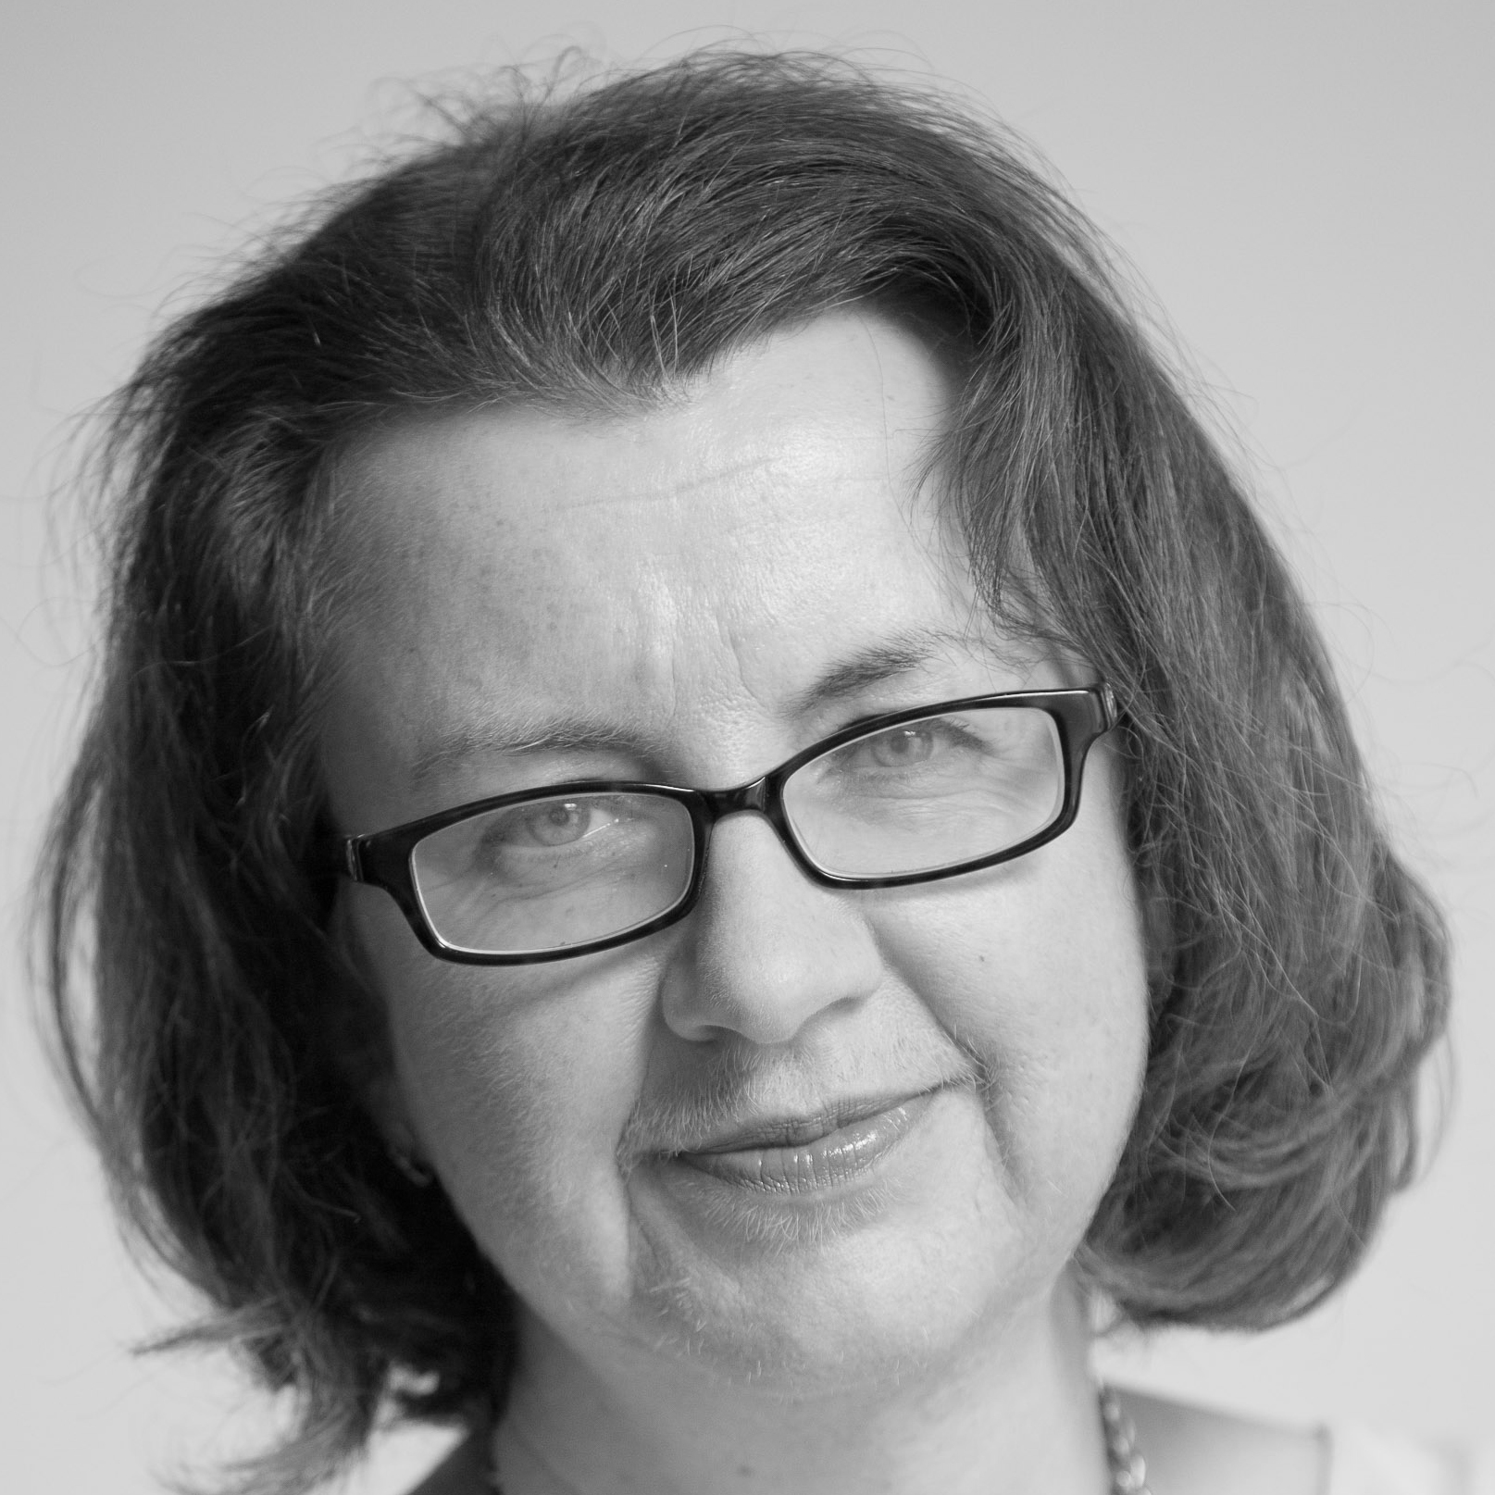
Arts, Humanities & Social Sciences
Geraldine Fitzgerald
Caroline Graber
Terry McDonald
Education
Psychology
Music & Music Technology
Classics
Gender & Women’s Studies
Law

Slide 8
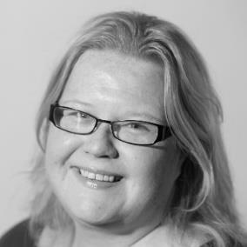
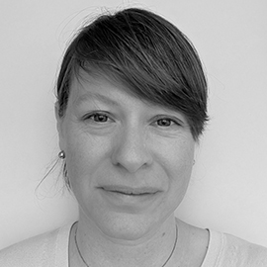
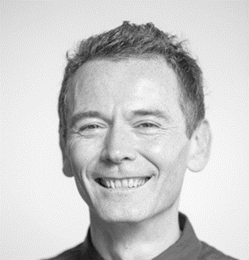
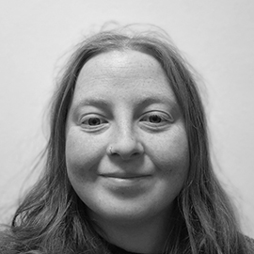
Health Sciences
Jessica Eustace-Cook
Leslie Kotzas
David Mockler
Aoife O’Connor
Nursing & Midwifery
Research Ireland Librarian
Nursing & Midwifery
Medicine, St James’s Hospital
Dental Science
Pharmacy

Slide 9
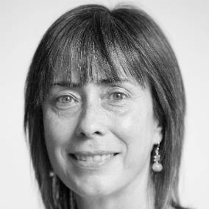
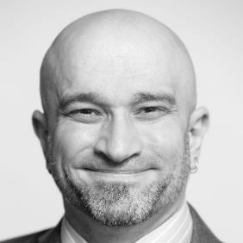
Science Technology, Engineering & Maths
Aoife O’Connor
Leslie Kotzas
Margaret Rooney
Greg Sheaf
Computer Science
Statistics
Genetics
Geology
Biochemistry; Biology
Botany
Environmental Science
Geography
Immunology
Microbiology
Molecular Medicine
Neuroscience (UG)
Zoology
Chemistry
Physics

Slide 10
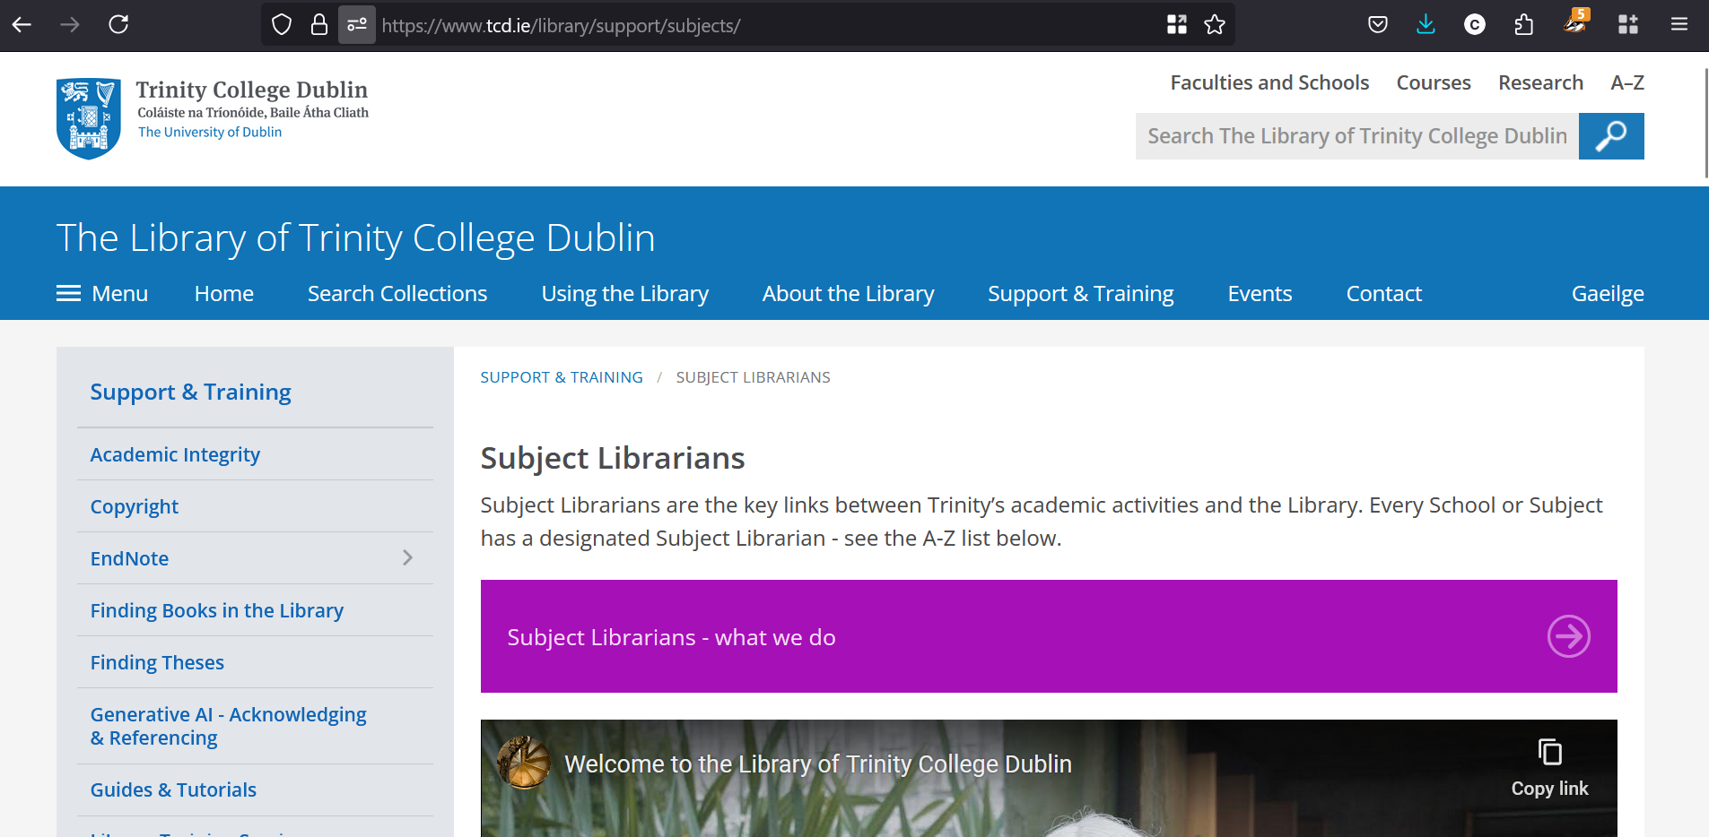
Quote Slide Option 2
https://www.tcd.ie/library/support/subjects/

Slide 11
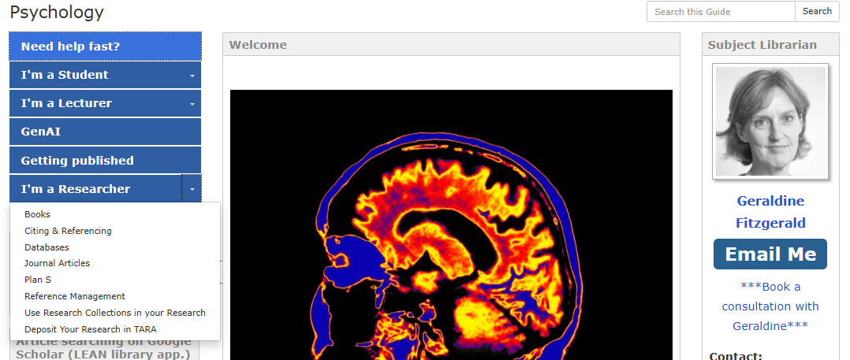

Slide 12
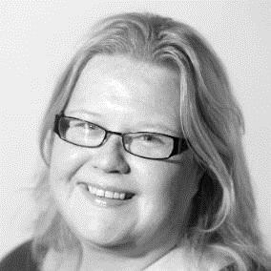
Jessica Eustace-Cook
Research Ireland Support Librarian
Jessica.Eustace-Cook@tcd.ie
For researchers in receipt of direct funding from Research Ireland
or affiliated to a Research Ireland funded research centre in Trinity
Can help you create your research profile in Trinity’s Research Support System (RSS) and maintain updates
Can help you to deposit your open access publications in the institutional repository, TARA
Can provide bespoke training sessions on research support tools including Endnote & Covidence

Slide 13
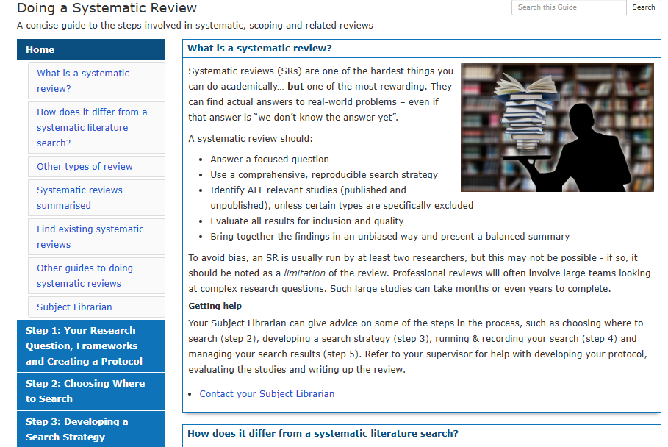
Research Guides & Tutorials

Slide 14
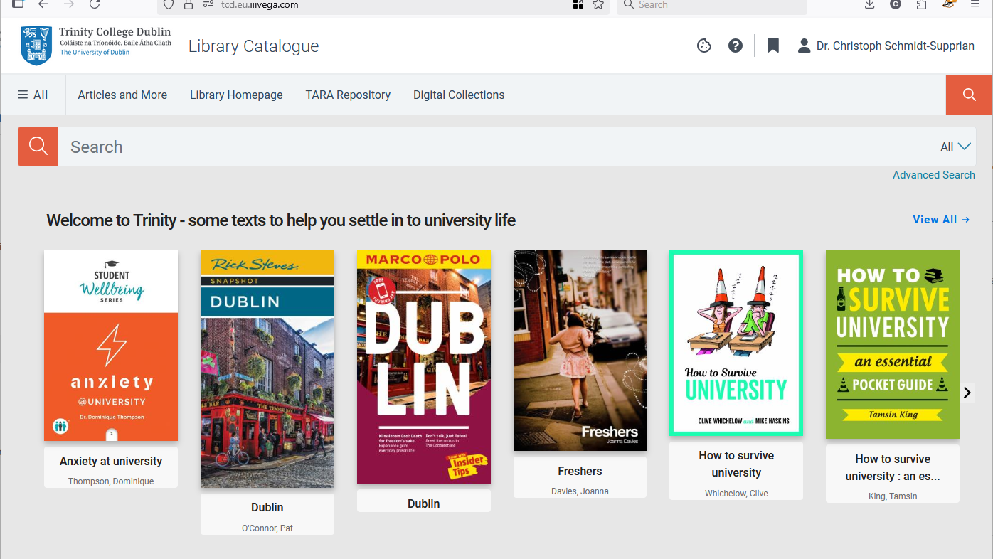
Image Slide
Trinity College Dublin, The University of Dublin

Slide 15
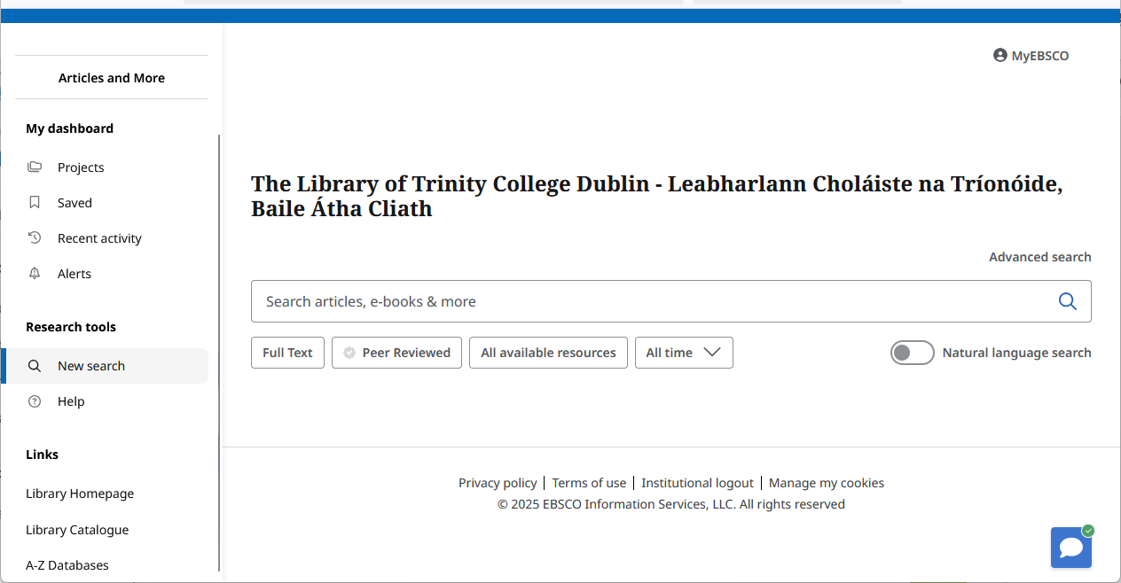
Image Slide
Trinity College Dublin, The University of Dublin
Notes:
Articles and more: essentially searching for individual publications across the library’s databases. Not all databases included (yet). Not all searchable to the same extent (of granularity).
Each database has its own bespoke interface for searching, browsing and discovering.

Slide 16
Image Slide
Trinity College Dublin, The University of Dublin
Notes:
Articles and more: essentially searching for individual publications across the library’s databases. Not all databases included (yet). Not all searchable to the same extent (of granularity).
Each database has its own bespoke interface for searching, browsing and discovering.

Slide 17
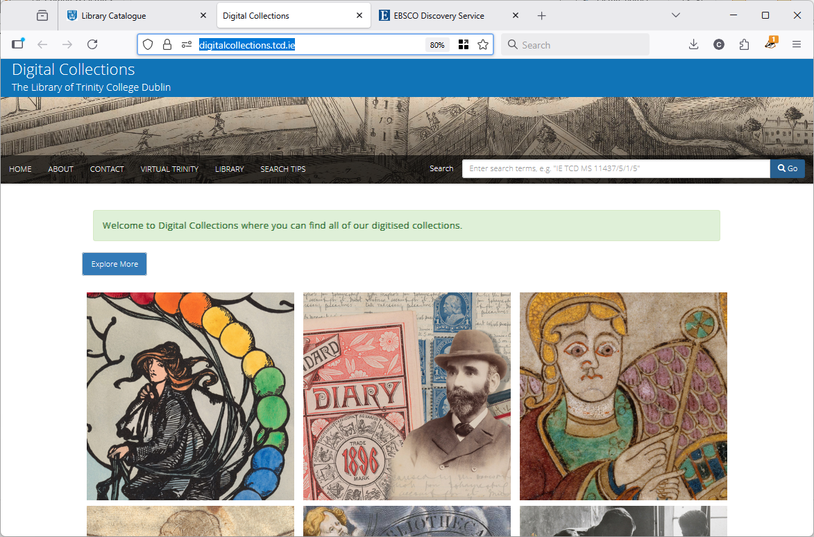
Image Slide
Trinity College Dublin, The University of Dublin

Slide 18
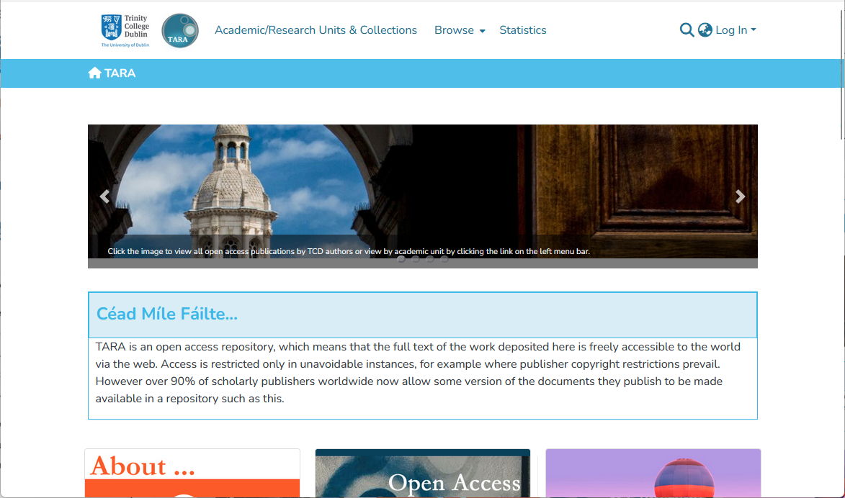
Image Slide
Trinity College Dublin, The University of Dublin

Slide 19
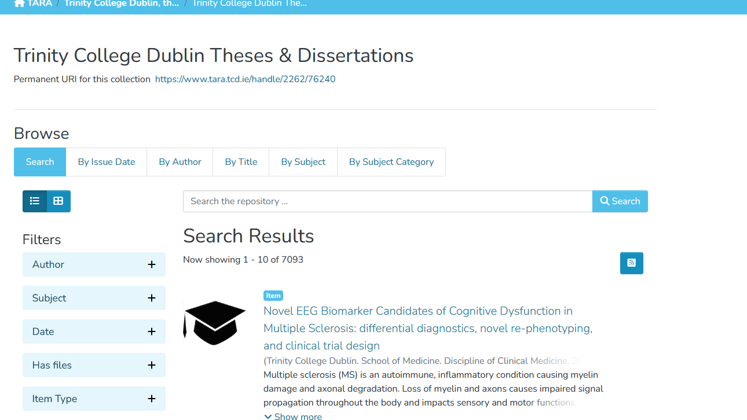

Slide 20
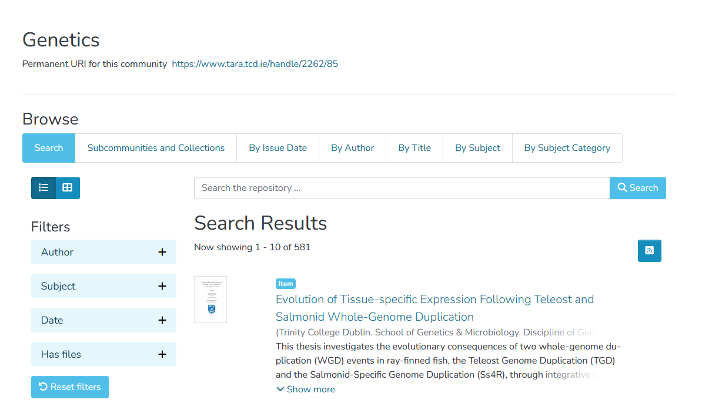

Slide 21
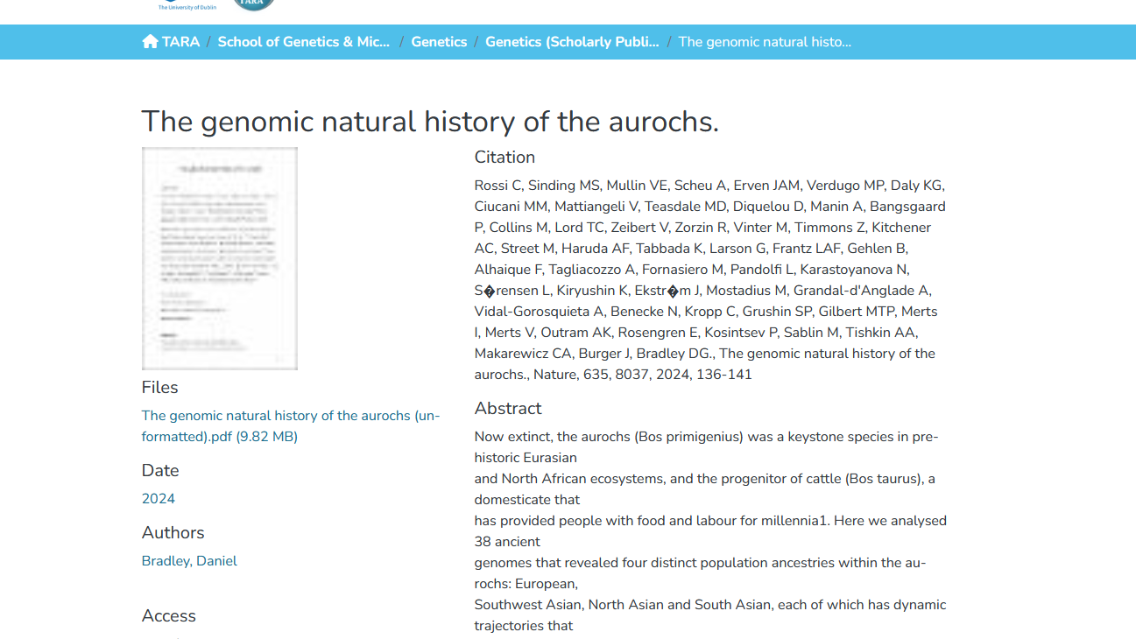
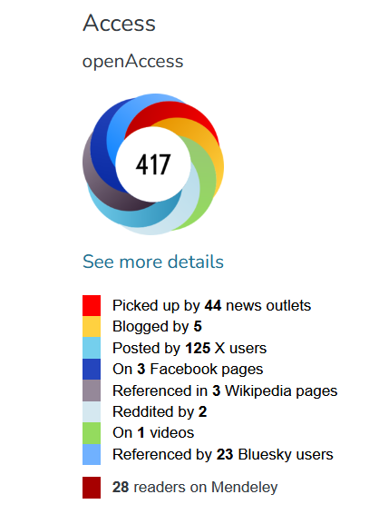

Slide 22
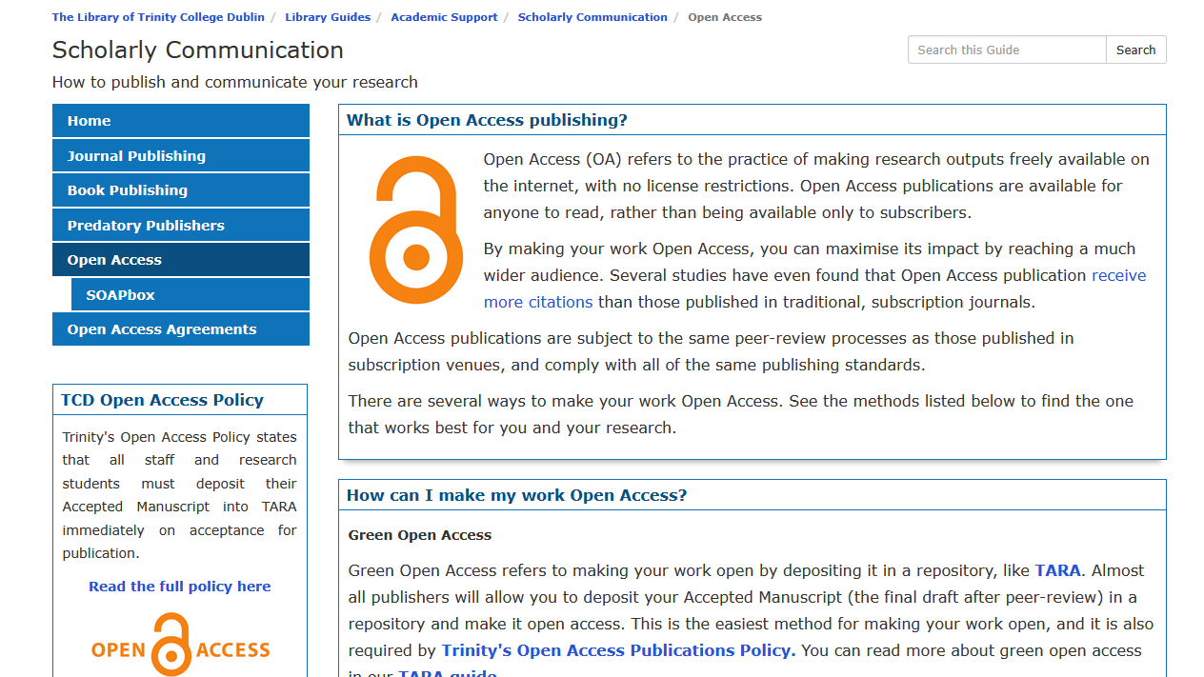

Slide 23
Research Policies at Trinity
Dr Jennifer Daly
Research Strategy & Policy Manager
Notes:
RSS = research support system

Slide 24
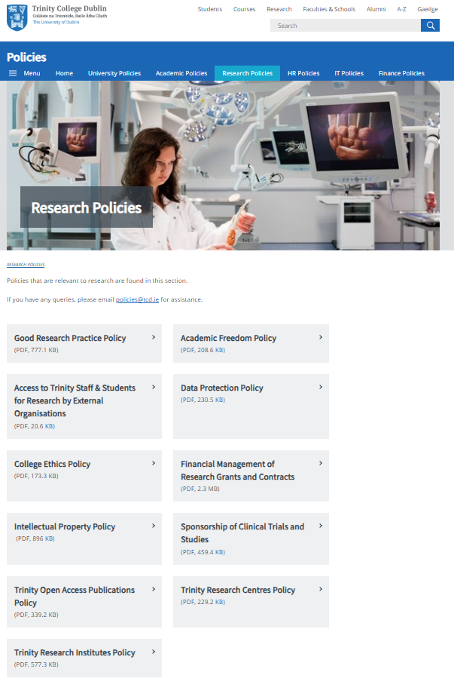
Research Policies at Trinity College Dublin
Why do we have research policies?
To ensure best practice across research activity
To protect researchers and those impacted by research
To maintain compliance with external and legislative obligations
To enable diversity and excellence in research
What do you need to know?
As a researcher, you have a responsibility to familiarise yourself with relevant policies
Check policies BEFORE beginning research or related activity
Notes:
How a profile looks on RSS
Student profile different to staff profile – you might have seen your supervisor’s profile

Slide 25
Policy on Good Research Practice
'Good research practice may, in certain cases, place some limits on the nature of research being carried out. However, the principle of academic freedom must at all times be defended. In so doing, the policy guides and protects the researcher, facilitating them to “work on their own challenging ideas, to be disruptive in their thinking, to do great research as individuals and collectively, and to excel at what they do”. In all cases where research is carried out under the auspices of College within or without the defined campus properties, the College requires compliance with the policies as set out in this document and related links and additional compliance with the policies of the relevant body of the organization wherein any external research is conducted. Failure to comply with the policies may result in disciplinary action under the College’s disciplinary procedures.'
(p.2, Policy on Good Research Practice)
Notes:
How a profile looks on RSS
Student profile different to staff profile – you might have seen your supervisor’s profile

Slide 26
Policy on Good Research Practice
Research Integrity
Inclusivity in research
Gender in research
Research misconduct
Training, supervision and mentoring of research
Research ethics; guidelines and processes for applying for ethics approval
Research data management
Good publication practice
Evaluating research
Notes:
How a profile looks on RSS
Student profile different to staff profile – you might have seen your supervisor’s profile

Slide 27
Other Research Policies
Academic freedom
Data Protection
College ethics policy
Intellectual property
Sponsorship of clinical trials and studies
Notes:
How a profile looks on RSS
Student profile different to staff profile – you might have seen your supervisor’s profile

Slide 28
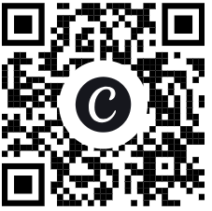
Where to find policies?
All college policies are online here:
https://www.tcd.ie/about/policies/
Research specific policies are here:
https://www.tcd.ie/about/policies/research-policies/
Scan the QR code to go directly to Research Policies
Notes:
How a profile looks on RSS
Student profile different to staff profile – you might have seen your supervisor’s profile

Slide 29
Research Ethics and Integrity
Corrinna Moore
  Research Ethics & Integrity Officer
Notes:
RSS = research support system

Slide 30
Research Ethics & Integrity
Research Integrity: standards for good research practices
behaviours around conducting research
a breach of this is called research misconduct
training is mandatory for all PhDs and is recommended for all researchers
Research Ethics: ethical principles to protect research participants
ensuring research is designed and conducted ethically-requires approval from a college REC
particular focus on protecting the rights and welfare of research participants
respect for their autonomy-informed consent
maximizing benefits & minimising harms
ensuring positive outcomes of research are shared with all equally
involves getting ethical approval for research in advance of any research starting
REAMs is the university approved online platform for applying for ethical approval
Notes:
How a profile looks on RSS
Student profile different to staff profile – you might have seen your supervisor’s profile

Slide 31
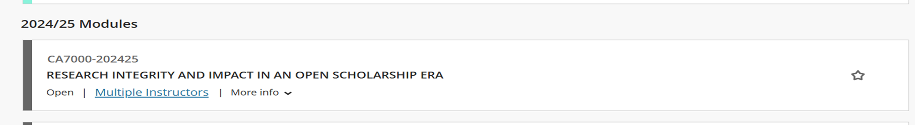
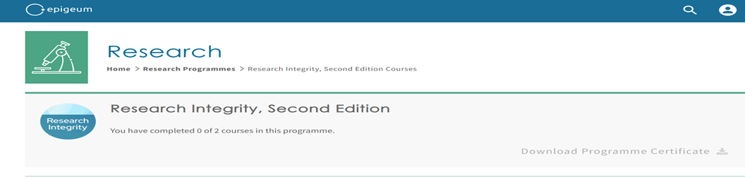
Research Integrity: main training programmes
CA7000 is mandatory for all PhDs-available via Blackboard
EPIGEUM available to all researchers and maybe required by some funders
Sample modules:
good research practice, research planning;
data protection, data management plans
research dissemination, research impact
Notes:
How a profile looks on RSS
Student profile different to staff profile – you might have seen your supervisor’s profile

Slide 32
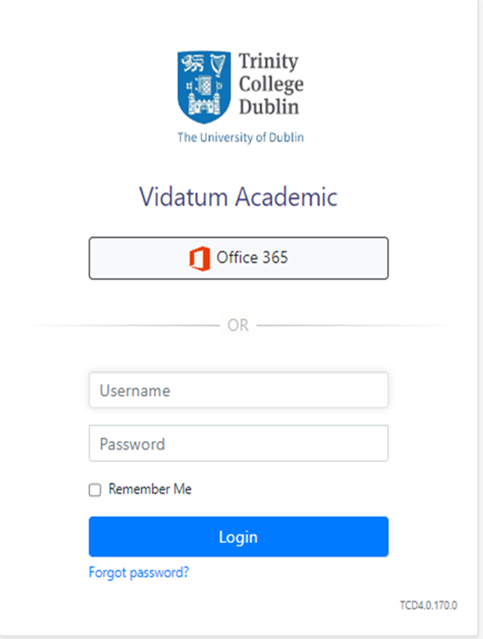
Research Ethics: Ethics Approval
Go to https://www.tcd.ie/research/support/ethics-approval.php
check that your research requires ethics approval
get familiar with the research ethics process in college
via our guidance manuals understand what happens if your
research requires data protection review
Postgraduates are automatically registered to use REAMs
Go to https://ethics.tcd.ie/
Log-in by clicking the office 365 icon
Help is available
consult the guidance manual
making an application presentation
FAQs
help box
Notes:
How a profile looks on RSS
Student profile different to staff profile – you might have seen your supervisor’s profile

Slide 33
Research Ethics: REAMS (Research Ethics Application Management System)
Supervisors must be added as collaborators on applications and must sign off on applications
Data Protection Review may be required: a pop-up with instructions will appear if your application triggers this
Research Ethics Committees review the applications
Risk level 1/2 routes to school REC, risk level 3 to faculty REC
check the REC’s website for dates
RECs give feedback through the platform; applicant is notified by email
Applications are rarely approved first time
give at least 1-2 months for the review process
give longer for applications that require data protection review and high-risk applications
Ethics Approval must be achieved before research starts
it cannot be granted retrospectively
failure to do so means that the research data is unusable for any academic or publishing purposes
Notes:
How a profile looks on RSS
Student profile different to staff profile – you might have seen your supervisor’s profile

Slide 34
PG Research Profile on RSS
Dr Jess Wang
  Senior Research Performance & Information Analyst
Notes:
RSS = research support system

Slide 35
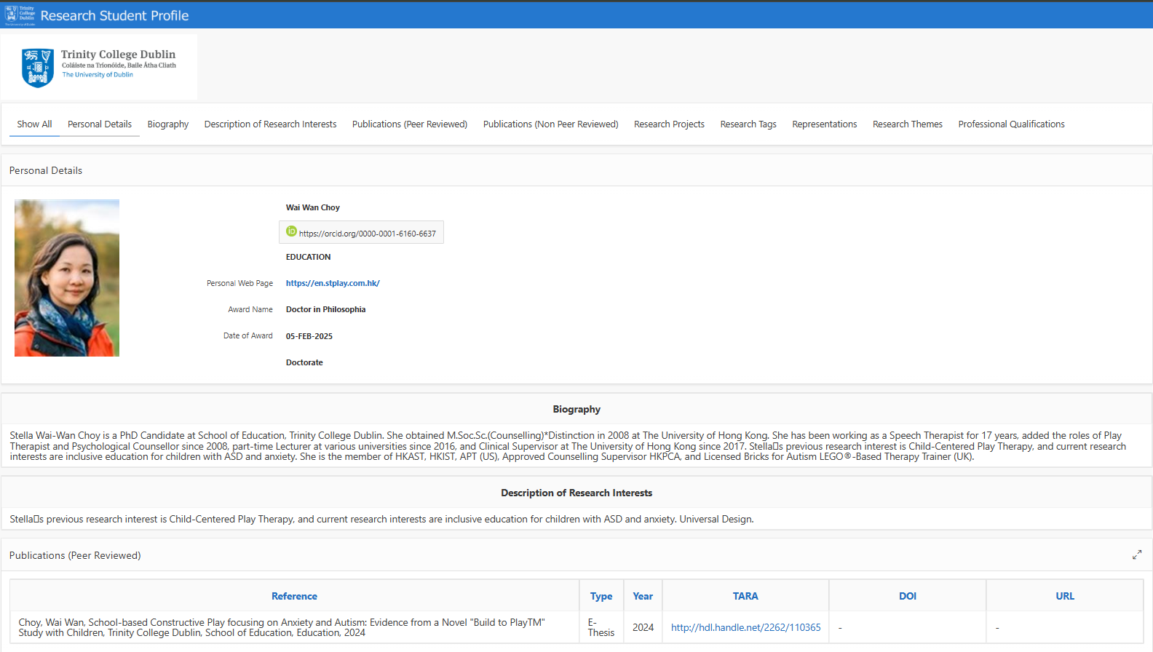
What is a research profile?
Notes:
How a profile looks on RSS
Student profile different to staff profile – you might have seen your supervisor’s profile

Slide 36
Why do I need a research profile?
Visibility
Building connections & network
Dissemination
Help others discover and use your work
Record keeping
Keep track of your work
Use for grant applications &
job applications

Slide 37
Importance of RSS data
RSS is a system to raise your profile, share your work and interests, and find collaborators
RSS data is fed forward to:
    Trinity People finder
    Sends publication details to TARA for upload of Open Access papers
RSS is useful for:
  Research CVs (narrative CV available)
  College Calendar
  e-Thesis submissions
  School and Faculty research activity analytics
Notes:
RSS connected to SITS (student info system) and HR system

Slide 38
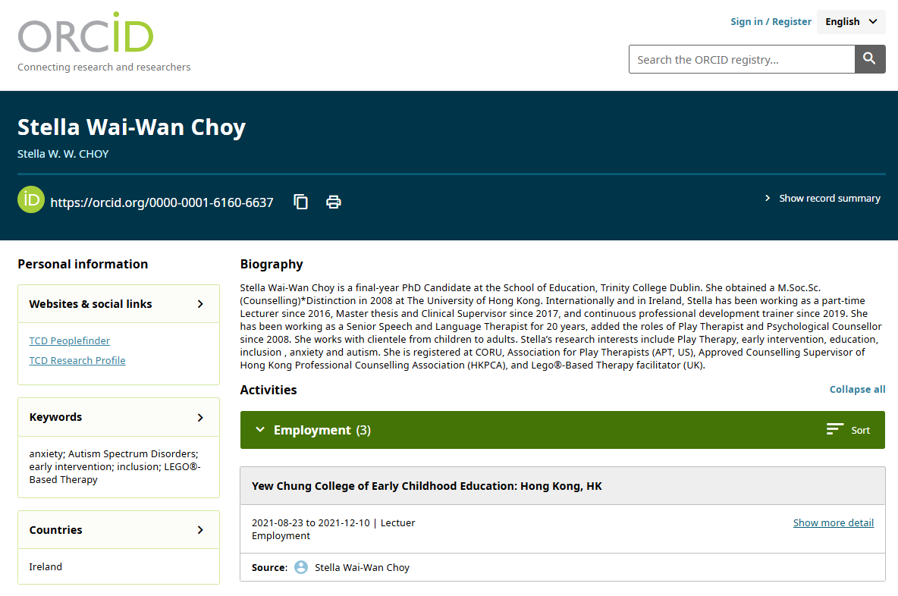
Where to host my profile?
Research Support System (RSS)
ORCiD: can be synced with RSS and a number of other platforms*
Other platforms:
Scopus*
Web of Science*
Google Scholar
ResearchGate
Academia.edu
Notes:
Many tabs across the top – all info that can be entered – you don’ have to fill in everything – consider what is most relevant for you.
RSS PG profile is only visible to Trinity staff and students but we are reviewing our systems
Good to get into the habit of updating your academic profile
Good to have an institutional profile – where people from Trinity will find you – ORCID and other platforms are portable if you move institution

Slide 39
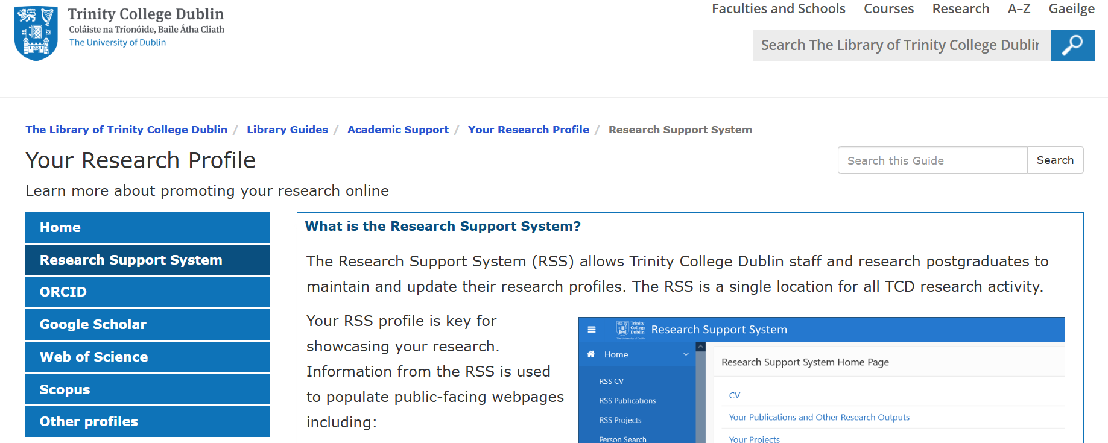
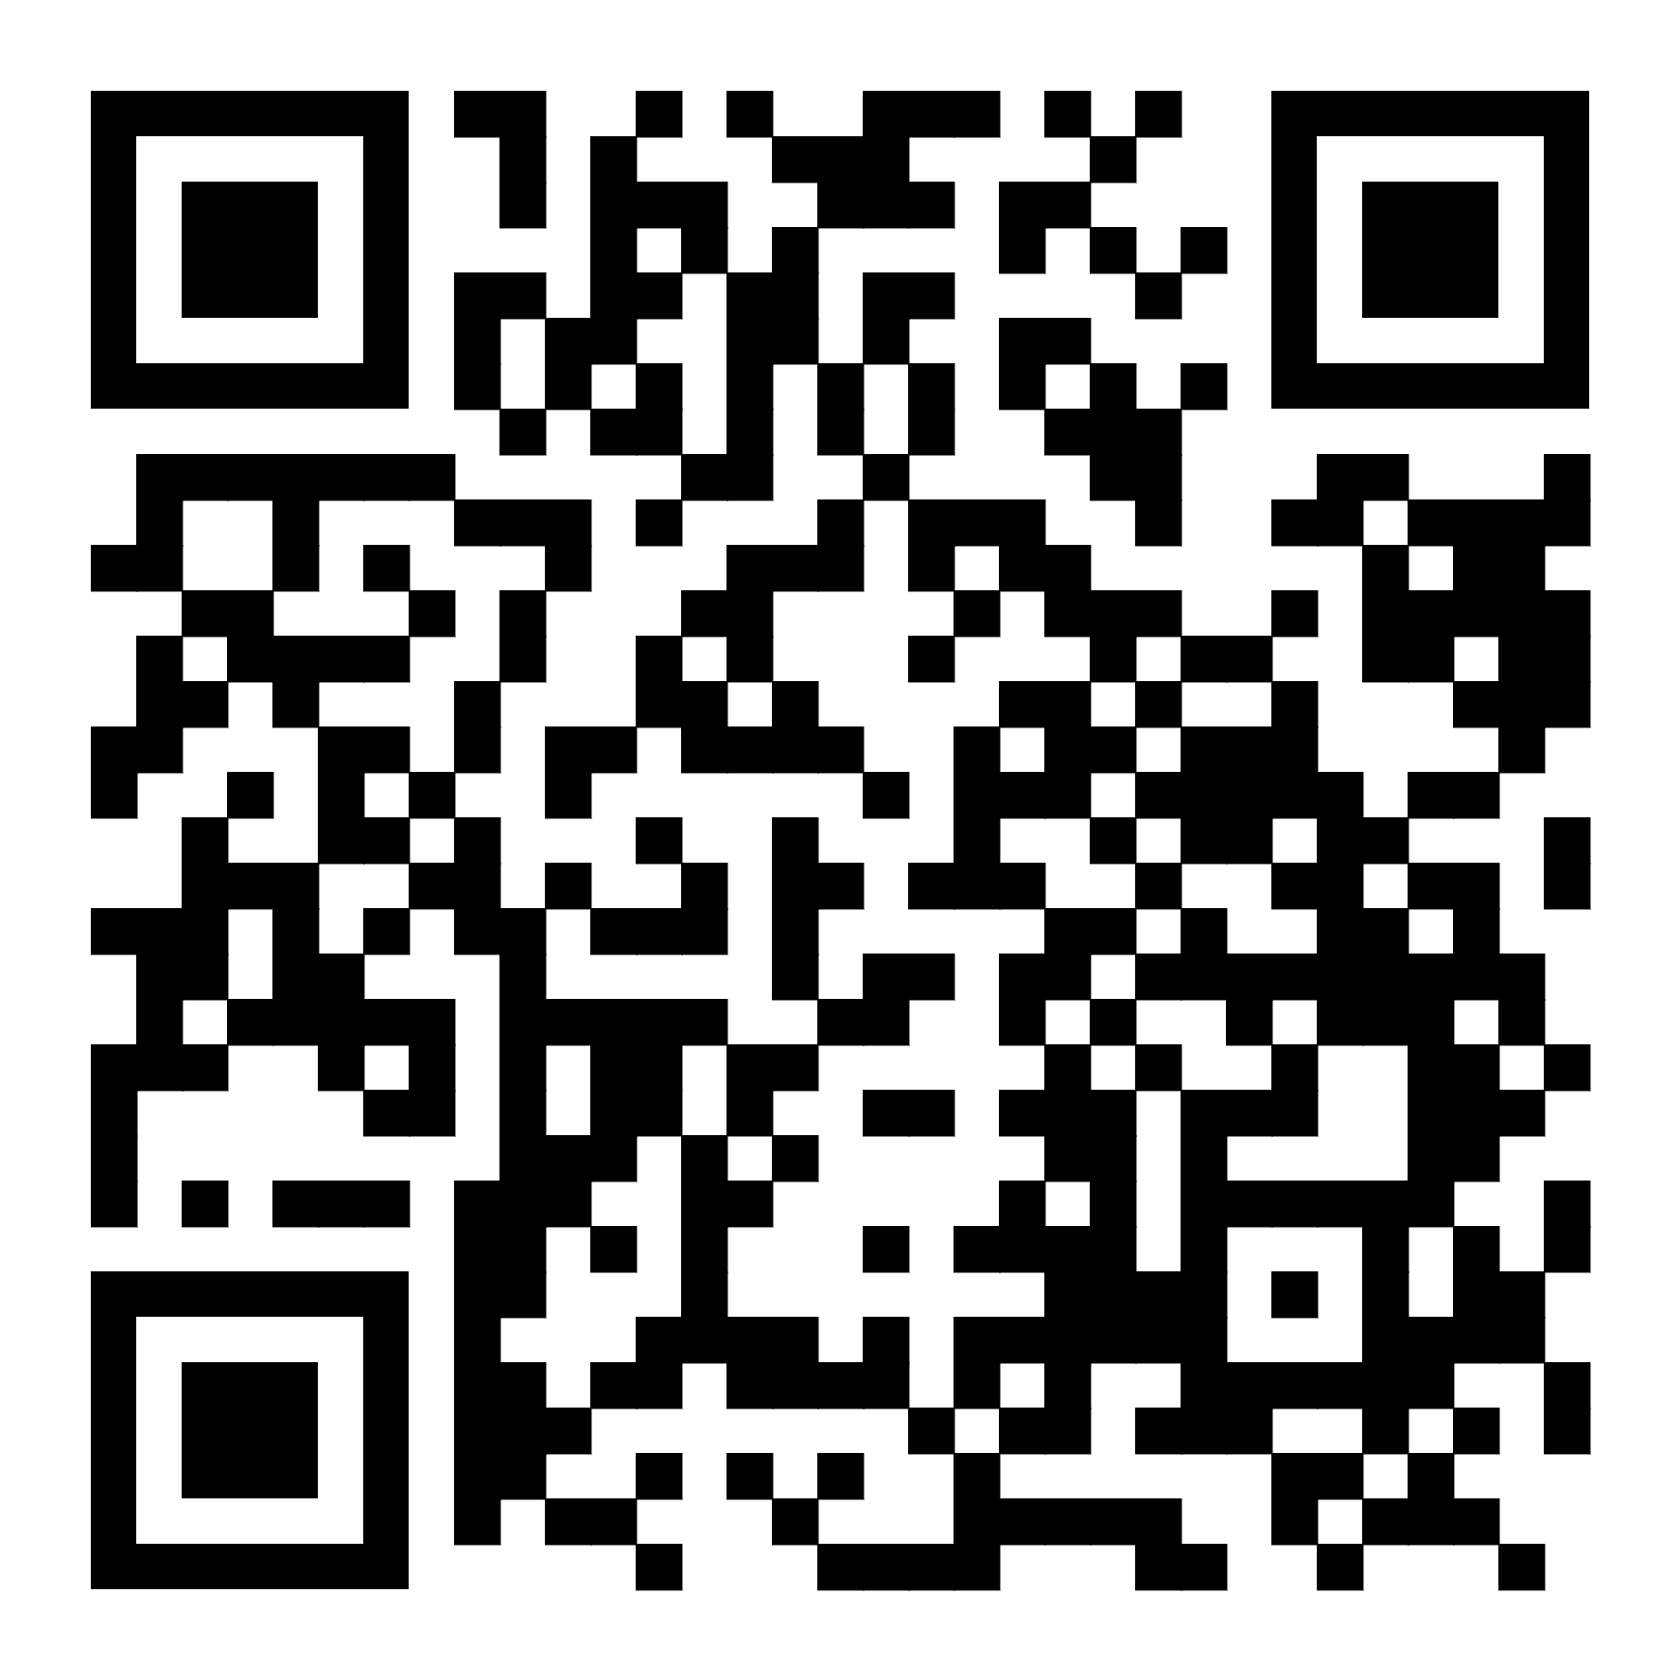
How to create an RSS profile
https://libguides.tcd.ie/researchprofile
Notes:
Choose the fields most relevant to you – don’t be overwhelmed by all the fields

Slide 40

Funding Opportunities for Postgraduate Students and Postdoctoral Researchers
Research Development Office
Trinity Research

Slide 41
Why apply for research funding?
Postgraduate
Postdoctoral
Independent Investigator
- Stipend funding
- Resources for your research
-Training / travel funding
- Fund your salary
- Resources for your research
- Grow your collaborations
- Build a research team
- Supervision experience
- Independent research
- Proposal writing experience
- Build research expertise
-Funding in your own name
- Expand international network
- Develop research career
- Manage a research project
- Leadership & mentorship
- Academic position
- Expand your network
Notes:
Depending on your discipline and the kind of research you do, you may not always need research funding to progress your career, but it helps in terms of providing critical resources, growing your research capacity and enhancing your profile. Resources and buying time for research are important across all career stages, but in general:
At an early career stage, you may need to fund your own salary or resource your fieldwork and conference travel. From a CV perspective, showing that you can attract funding will also significantly enhance your profile and desirability for tenure track positions, while you can also gain valuable international experience.
As you transition towards independence, funding can be valuable for growing your team and capacity, bringing in PhD students and postdocs growing your international and interdisciplinary collaborations. A bigger team increases publications and grows your leadership and mentorship experience, which can support promotion applications.
Even as a senior researcher, being able to attract large-scale funding can help you pursue new research ambitions and new collaborations, sometimes buy out time for you to take your research somewhere new, and overall increase your prestige, international recognition and prospects for senior leadership positions.

Slide 42
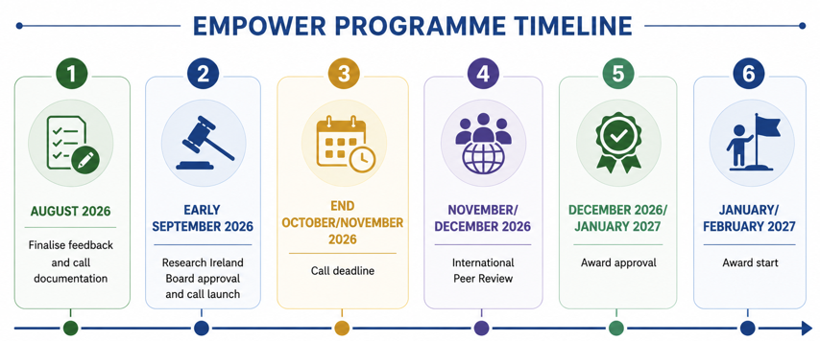
Research Ireland EMPOWER
Notes:
indicative timeline, noting this came from RI and is subject to change at their discretion. anyone interested in the EMPOWER programme should sign up for updates from Trinity (Research Focus)
Research Ireland is currently developing a proposed new programme, Empower, which is intended to encapsulate the Government of Ireland (PhD and postdoctoral) and other programmes.
Subject to the consultation process and Board approval, Research Ireland's current intention is that Empower will open in late September.
The proposed Empower programme is intended to support the next generation of research talent while strengthening research environments. Under the model currently being consulted upon, Research Ireland would peer review and assess institutional applications rather than applications from individual researchers. Under the proposed programme, funding would be awarded at an institutional level, PhD and postdoctoral applicants would apply through their chosen institution.

Slide 43
Scholarships at Trinity College
International scholarships: Open to students from certain countries
Themed Scholarships: Available for research projects in a defined theme/discipline (e.g Mathematics, Law, History etc.)
More information on scholarships here
Research Ireland Enterprise Partnership Scholarship
PhD project co-funded by an enterprise partner (industry, charity, NGO etc.)
Funds stipend (€25k/year), fees and research expenses (€3250) for 4 years
Due to open in Q4 2026
Postgraduate Funding Opportunities

Slide 44
MSCA Fellowships
EUROPEAN FELLOWSHIPS (12-24 months*)
- Funds researchers to move to/within Europe
GLOBAL FELLOWSHIPS (GF) (24-36 Months*)
- Funds researchers to move outside Europe, with a mandatory 12 month return to country of origin
Research Ireland Enterprise Partnership Scholarship
Postdoctoral fellowship co-funded by an enterprise partner (industry, charity, NGO etc.)
Funds salary and research expenses (€5000) for 2 years
Due to open in Q4 2026
Research Ireland Public Service Fellowships
Secondment to Public Service
Funds salary and direct costs up to €130,000 over 1 year full time or 2 years part time
Due to open in early 2027
Postdoctoral Funding Opportunities

Slide 45
External funding – where to find opportunities?
Research Professional
Research Focus Newsletter
RDO Funding Info Events
Academic networks, peers, mentors, collaborators
Websites such as EURAXESS, jobs.ac.uk,
Notes:
Research Professional best for tailored funding searches. Trinity has a subscription so you can create an account, do keyword searches, access their deadline calendar and set up email alerts. They have training sessions on how to use, including two coming up in the next 6 weeks.
Sign up for our Research Focus newsletter for regular funding updates and event notices.
You’ll find opportunities to work on funded projects on these academic and research job search sites. EURAXESS for opportunities across Europe.
As you build your networks of collaborators, let people know you’re interested in funding opportunities where you could collaborate.
RDO run annual funding info days for a deeper dive into all the funders. You can access the recording of our event from last October at this link and we’ll have another one this October.

Slide 46
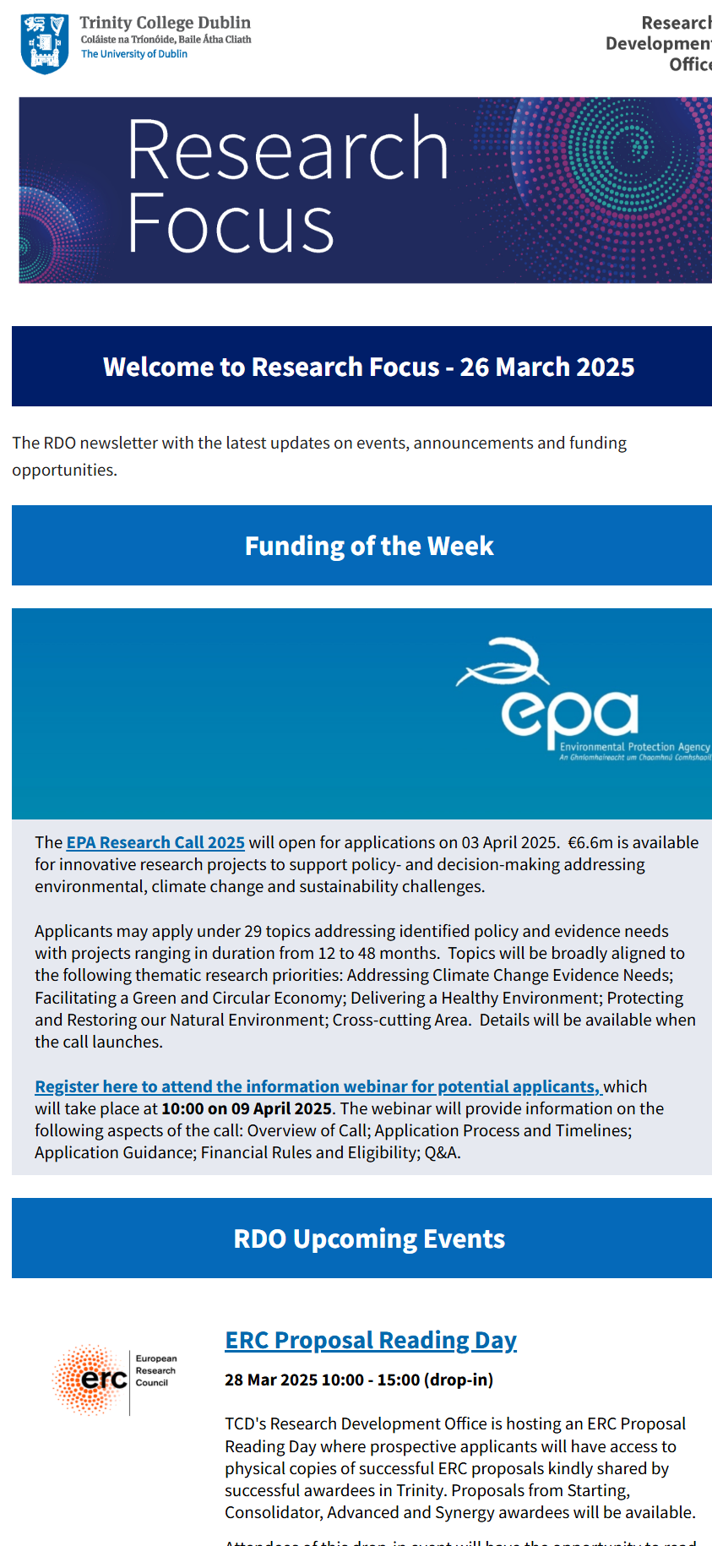
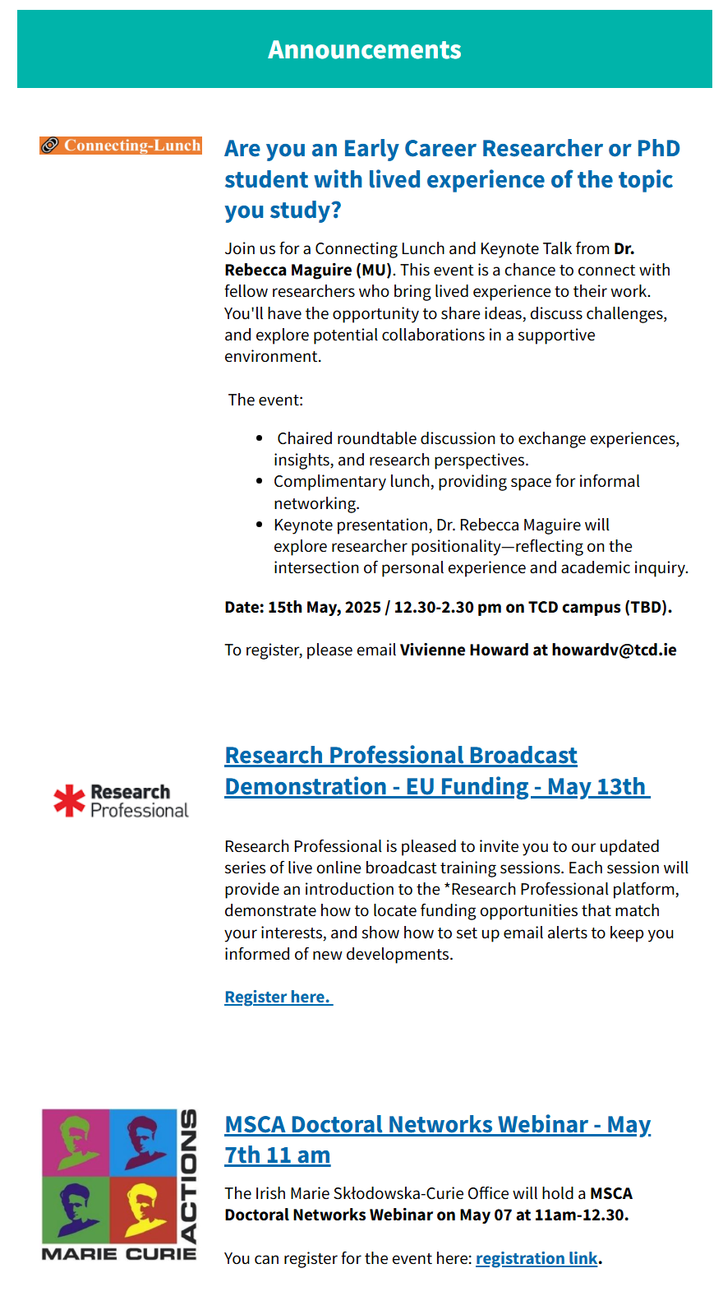
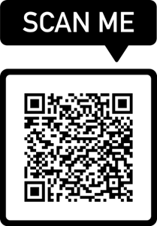
Research Focus
E- newsletter
Research Focus – sent out every Wednesday + extra issues for relevant funding calls and training
Subscribe here

Slide 47
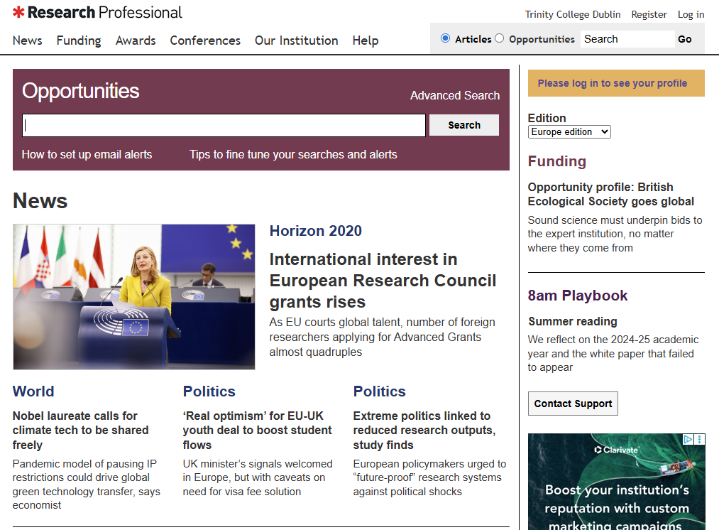
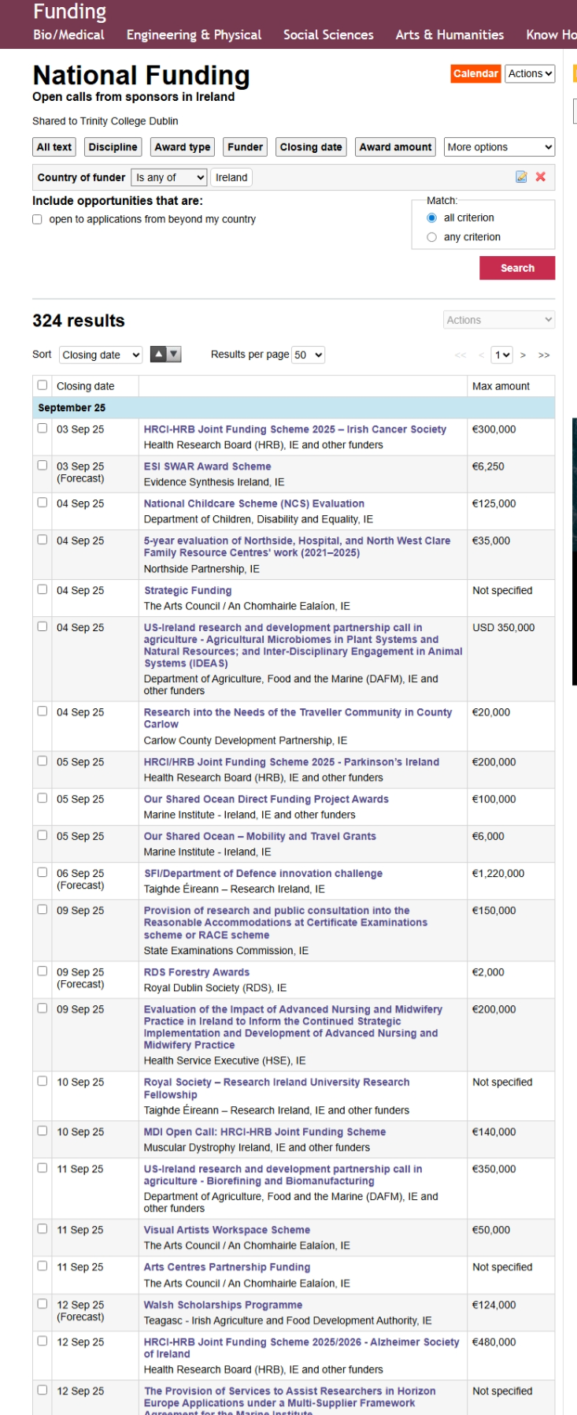
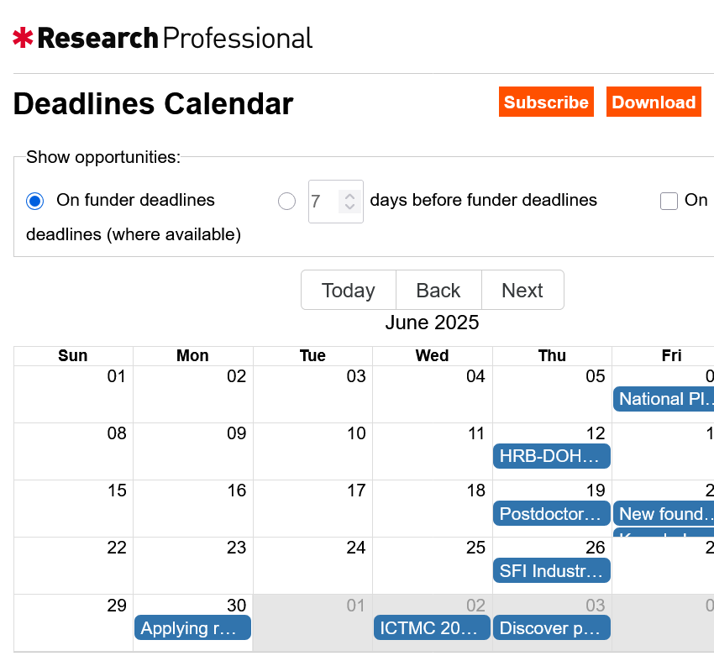
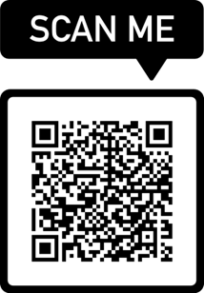
Research Professional Alerts Service
All Trinity staff have free access to the Research Professional online database of research funding opportunities.
Access Research Professional here

Slide 48

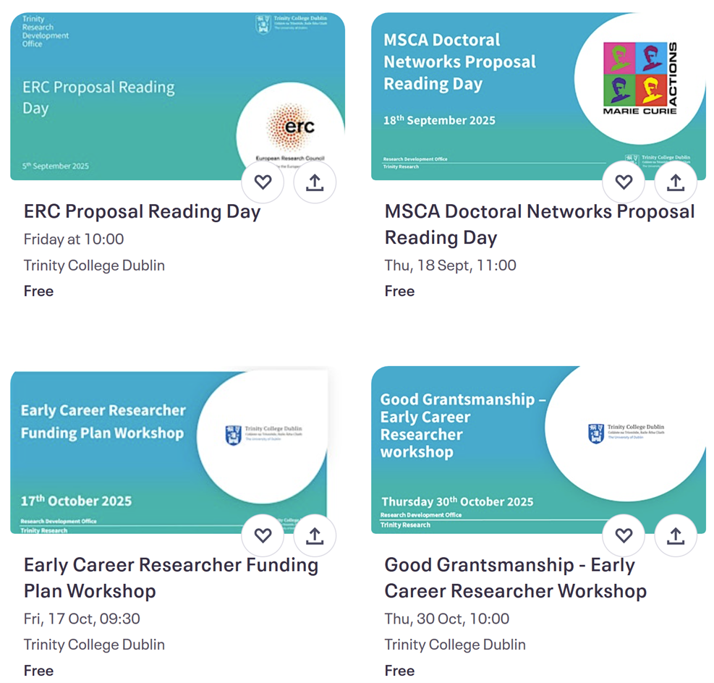
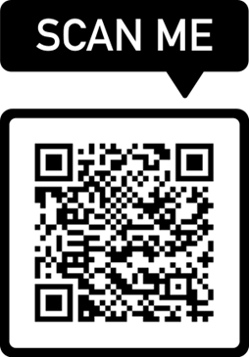
Training & Events
Regular events organised by Research Development Office on funding schemes, grant writing, building research networks, etc.
See our Eventbrite page for more details

Slide 49
Human resources slide 3
Get in touch
research.office@tcd.ie
Research Development Office
Thank you

